Slide 1
Credit Risk Analysis
Anushree Tomar

Slide 2
Importance of Credit Risk Analysis
Analysis of good and bad credit rating is important for the business of bank because on the basis of applicants' credit rating they are going to approve the loan.
Generally they approved the loan of applicant with good credit rating.
Predictive model on the data will helps in decision making weather to approve loan or not based on Applicant profile.

Slide 3
Exploratory Data Analysis
Observations: 1000
Variables: 30 Independent variables
Numerical variable-6
Categorical variable-25 including response variable

Slide 4
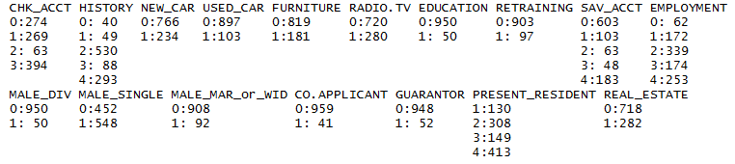

Summary of Categorical Variable giving their Respective Frequency

Slide 5
Summary from previous slide
Maximum number of checking account status is with -3: no checking account
Maximum number of credit history with -2: existing credits paid back duly till now
Maximum number of Average balance in savings account is with -0 : < 100 DM
Maximum number of Present employment since is with 4 : >= 7 years
Present resident since – years is with 2<…<=3 years
Maximum in number 2 : skilled employee / official
For binary 1=yes,0=no

Slide 6
Histogram Analysis(R-code line 82)
Frequency of 10 to 15 months is higher than 20-25 months
Frequency of 100 -300 Amount is maximum(uniform distribution)
Instalment rate is left skewed means instalment value is decreasing from 4 to 1 towards left.
Frequency of 5to10 Age is maximum
Number of credit with 1 is more

Slide 7
Correlation analysis(code-line 90)
Amount and Duration is moderately positive correlated with value 0.63
Box-plot analysis(code line-140)
Outliers are present in Age and Duration variable

Slide 8
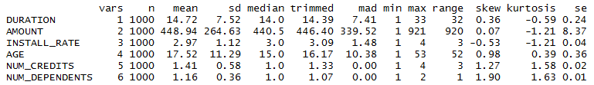
Summary Statistics of Numerical Variable

Slide 9
Analysis of credit history with respect to Response Variable
Group | 0 | 1 | 2 | 3 | 4
0 | 25 | 28 | 169 | 28 | 50
1 | 15 | 21 | 361 | 60 | 243
Analysis of saving Account with respect to Response Variable
Group | 0 | 1 | 2 | 3 | 4
0 | 217 | 34 | 11 | 6 | 32
1 | 386 | 69 | 52 | 42 | 151

Slide 10
Analysis of Owns real Estate with respect to Response variable
Analysis of employment with respect to Response variable
Group | 0 | 1 | 2 | 3 | 4
0 | 23 | 70 | 104 | 39 | 64
1 | 39 | 102 | 235 | 135 | 189
Group | 0 | 1
0 | 240 | 60
1 | 478 | 222

Slide 11
Conclusion from previous slide
Maximum number of good credits rating and bad credit rating is with category '2: existing credits paid back duly till now ‘. But number is more with good credit score.
Maximum number of good credits rating and bad credit rating of Average balance in saving Account is with category- 0 : < 100 DM. But number is more with good credit score.
Maximum number of good credit rating belong to category of employment -2 : 1 <= ... < 4 years
Applicant owns real estate category- 0:No have Maximum good credit rating.

Slide 12
Conclusion from box plot(code line-175)
From Box plot of Duration with response variable we observe that with less duration of credit in month have good credit rating.
Same with credit amount, less credit amount more good Rating

Slide 13
Summary Statistics of Duration variables
Minimum Duration of Credit is 1 month
Maximum Duration of Credits is 33 months
Average Duration of Credits is 14.72 months
Median of Duration is 14 months
Data is positively skewed means Duration of data is distributed towards right about its mean Duration value.
As shown by values mean > median
Kurtosis is –ive means that tail data is less than the tails of the normal distribution

Slide 14
Amount
Maximum Credit Amount: 921
Minimum Credit Amount:1
Average Credit Amount: 448.94
Median Credit Amount: 440.5
Skewness: Positive(right)
Kurtosis: negative

Slide 15



Instalment rate as % of disposable income
Frequency of instalment
(skew, kurtosis = negative)
Frequency of Number of Dependents
Frequency of Number of Existing Credits
Max. Age:53 years
Min. Age:1 years
Median Age:15 years
Average Age: 17.52 years
Notes:
Rest variables are positive skewed and positive kurtosis

Slide 16
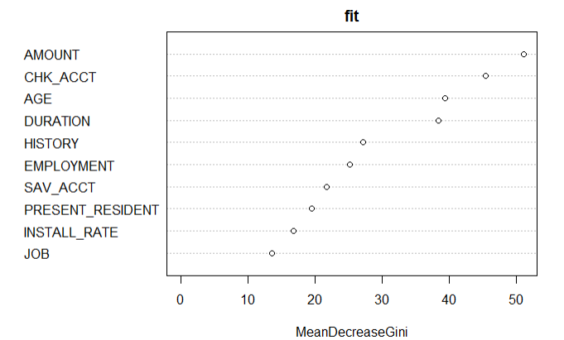
10 important Variables for Prediction of Credit Rating
Notes:
The most important variable of the credit rating is Credit Amount, followed by Checking Account status, Age, months and credit history

Slide 17
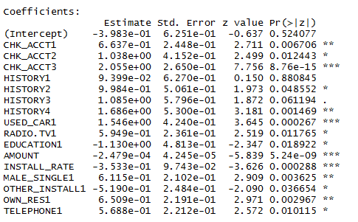
Coefficient of Logistic regression showing significant variable with Accuracy of 68%

Slide 18
Prediction Model
Model performance is good with Non-linear Classifier(SVM and Random Forest) with accuracy= 73% and 76% respectively .
For Final Model Selection F1 is good measure to select .
For above model F1 score is 1 for both.
We should focus on minimizing FP and FN value.
For example Model predicted Negative(bad rating) outcome but in actual it is good, so it may cause financial loss to bank.

Slide 19
Thank you

